Slide 1

Gene tree - species tree models,
with a focus on
gene duplications, transfers, and losses
Bastien Boussau
Laboratoire de Biométrie et Biologie Évolutive Université de Lyon
CoME, 2022

Slide 2
Plan
The need for gene tree species tree models
Using a model of gene transfers, duplications and losses (DTL) to reconstruct species and gene trees
Using a DTL model to compare genome evolution in Fungi vs Cyanobacteria
Using a DTL model to reconstruct ancestral genomes in Archaea
Using a DTL model to date species phylogenies

Slide 3
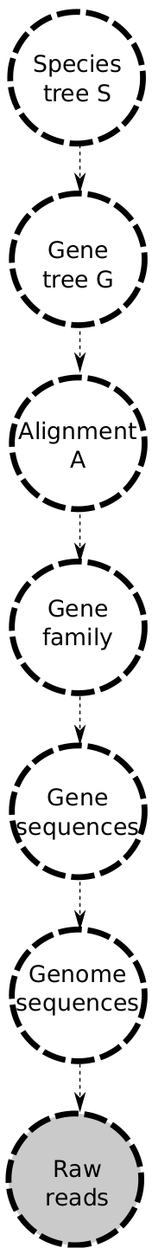
The phylogenomics pipeline

Slide 4
The phylogenomics pipeline

Slide 5
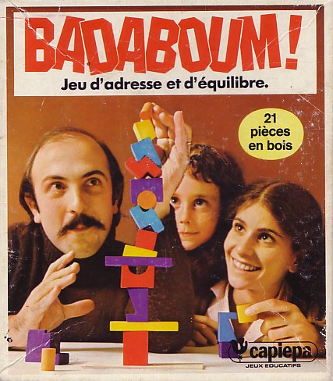
The phylogenomics pipeline
Uncertainty?
Uncertainty?
Uncertainty?
Uncertainty?
Uncertainty?
Uncertainty?

Slide 6
The phylogenomics pipeline
Uncertainty?
Uncertainty?
BAli-Phy
Uncertainty?
Uncertainty?
Uncertainty?
Uncertainty?

Slide 7
The phylogenomics pipeline
Uncertainty?
Gene tree-species tree models
Uncertainty?
BAli-Phy
Uncertainty?
Uncertainty?
Uncertainty?
Uncertainty?

Slide 8
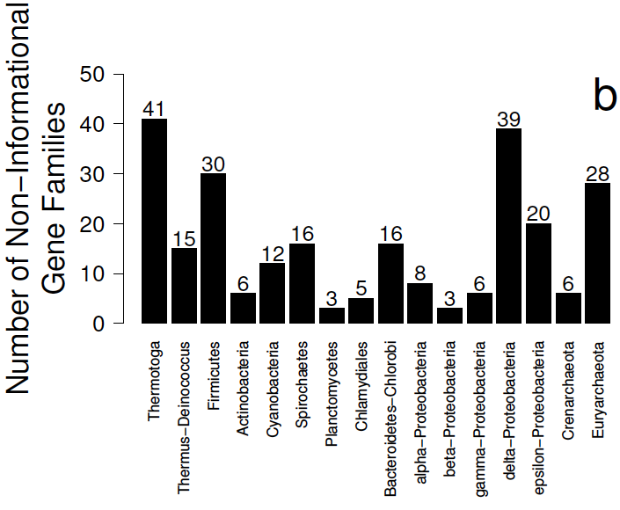
Gene trees provide confusing signal about species relationships
Aquificales
?
Other
HOGENOM database
Boussau, Gueguen, Gouy, BMC Evol. Biol. 2008

Slide 9
The need for a gene tree-species tree model
There is a lot of incongruence between gene trees, and therefore between gene trees and the species tree
To know how much of it is biological and how much of it is methodological, we need to model biological processes, notably gene transfers
Incongruence ~
Biological
+
Methodological

Slide 10
The need for a gene tree-species tree model
There is a lot of incongruence between gene trees, and therefore between gene trees and the species tree
To know how much of it is biological and how much of it is methodological, we need to model biological processes, notably gene transfers
Incongruence ~
Biological
+
Methodological
Incongruence ~ Duplications + losses + Transfers + ILS + Error

Slide 11
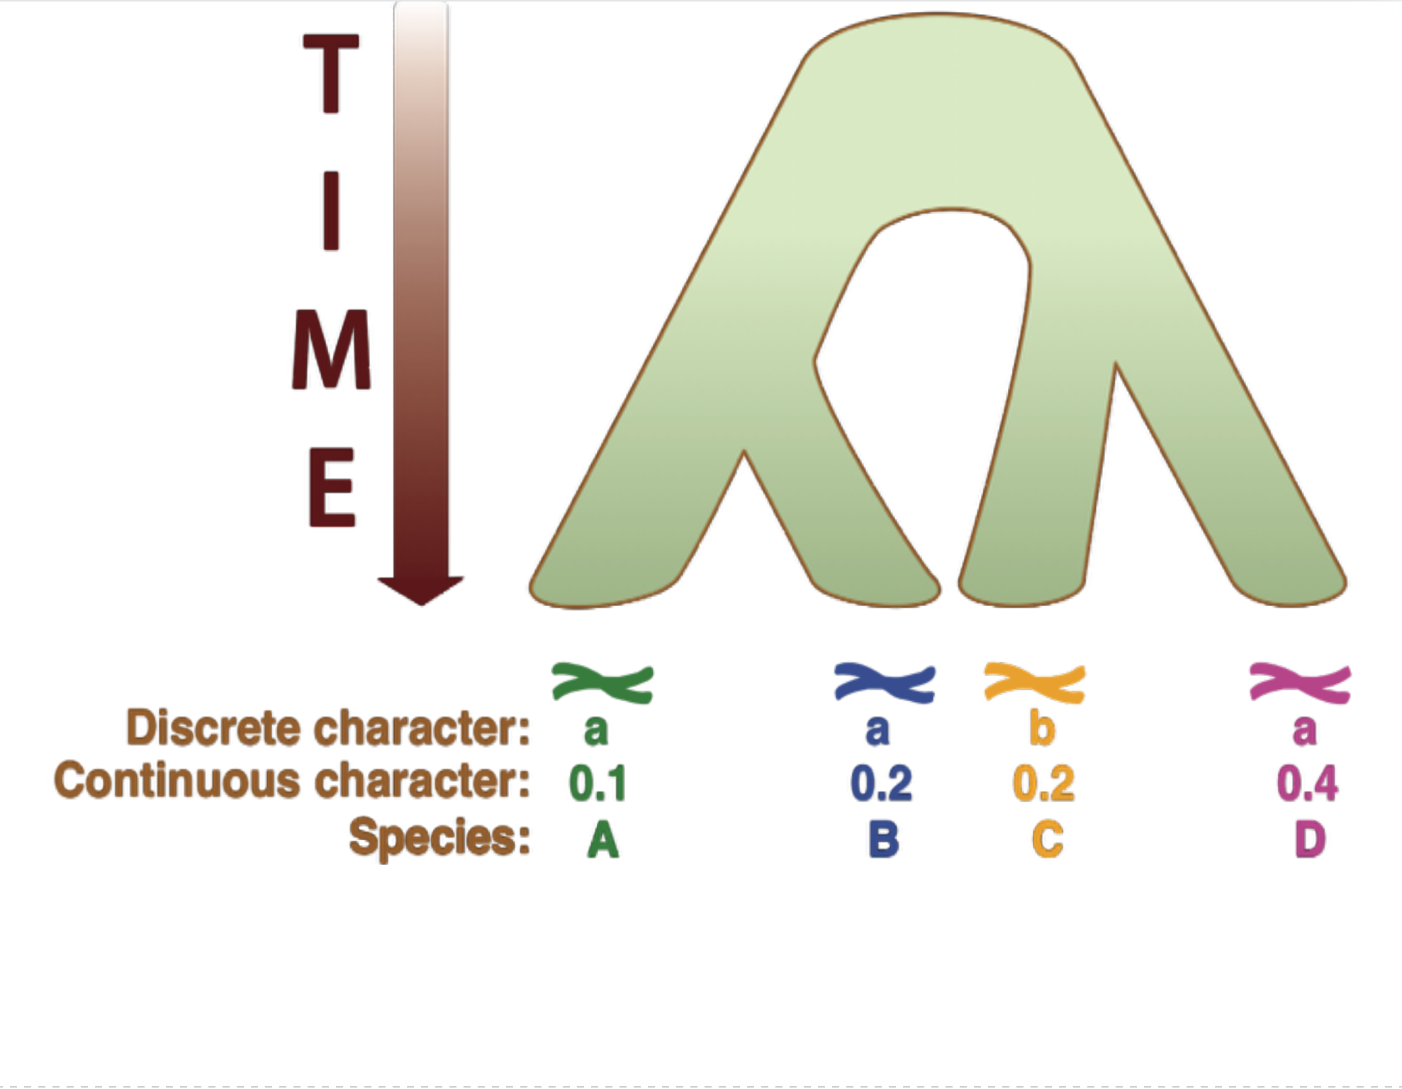
Biological processes creating incongruence
Notes:
Here is a species tree, with the root at the top. At the tips, we can find the genomes, and other characters of interest for species A B C D.

Slide 12
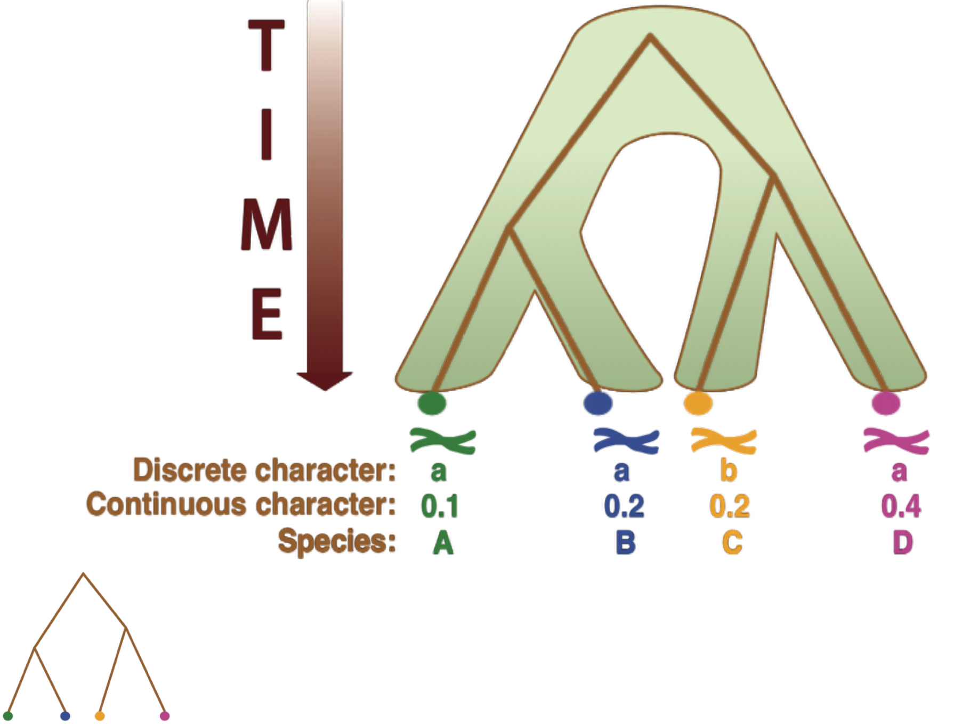
Biological processes creating incongruence
Notes:
Some genes have an evolutionary history that closely resembles that of the species. Those are families of orthologous genes that would be the best candidates for inferring a species tree, if we had a way of finding them a priori, which we don’t.
(NB: although the topology of this gene family is identical to the species tree, the divergence times are a bit older in the gene family compared to the species tree. This is expected under a model of speciation without reticulation.)

Slide 13
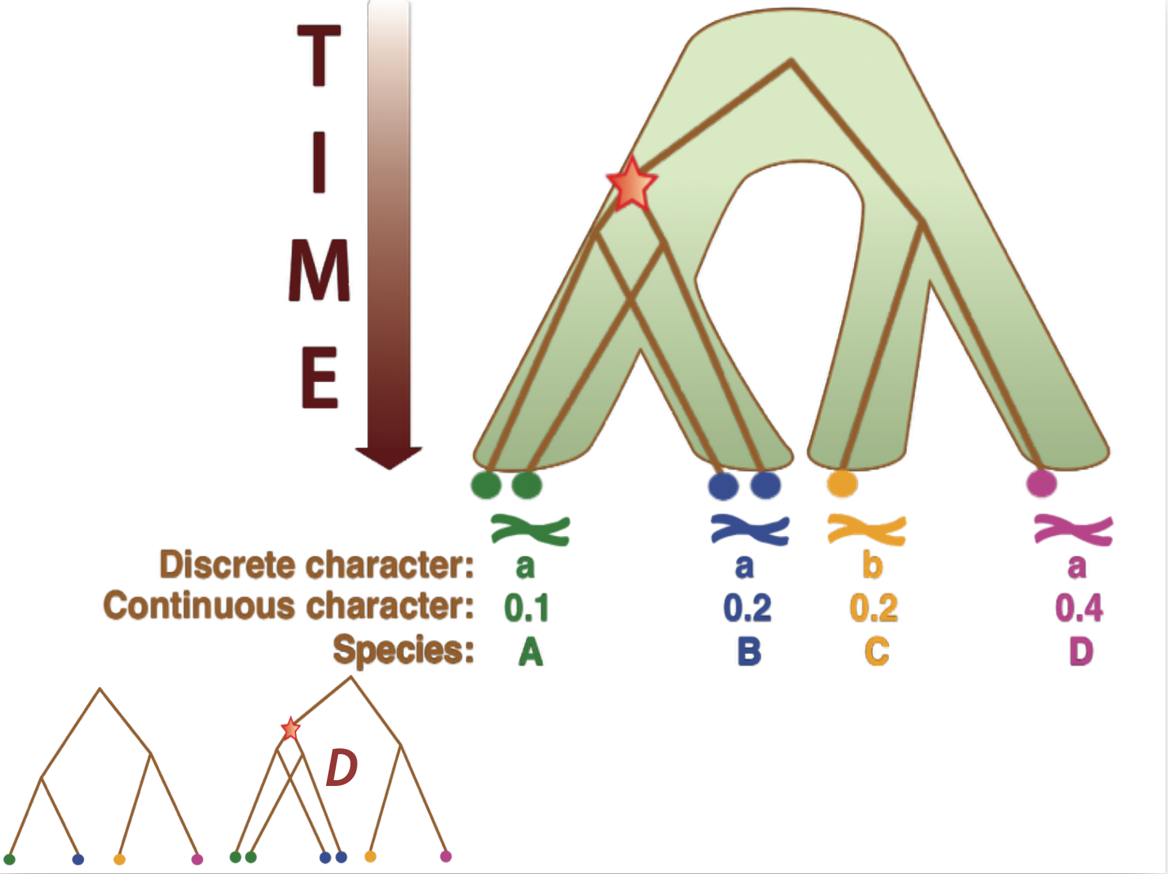
Biological processes creating incongruence
Notes:
Other gene families have a slightly more complicated history, for instance they may have undergone an event of gene duplication. Here, a duplication in an ancestor of species A and B, so that those two have 2 copies of this gene family.

Slide 14
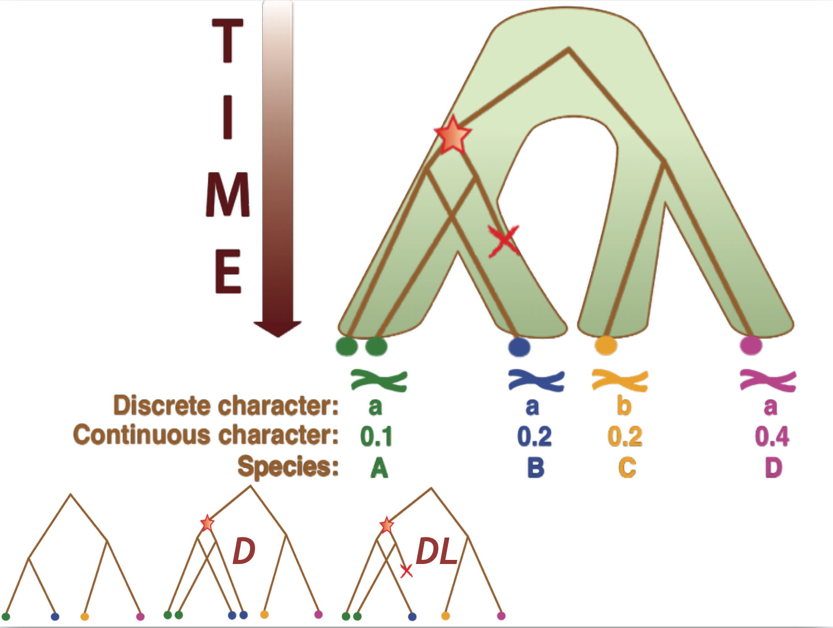
Biological processes creating incongruence
Notes:
If in addition to the gene duplication there is a loss, then the history becomes a bit more complicated.
(NB: In the case presented here, just looking at the number of copies in each genome is not enough for assigning where the duplication took place.)

Slide 15
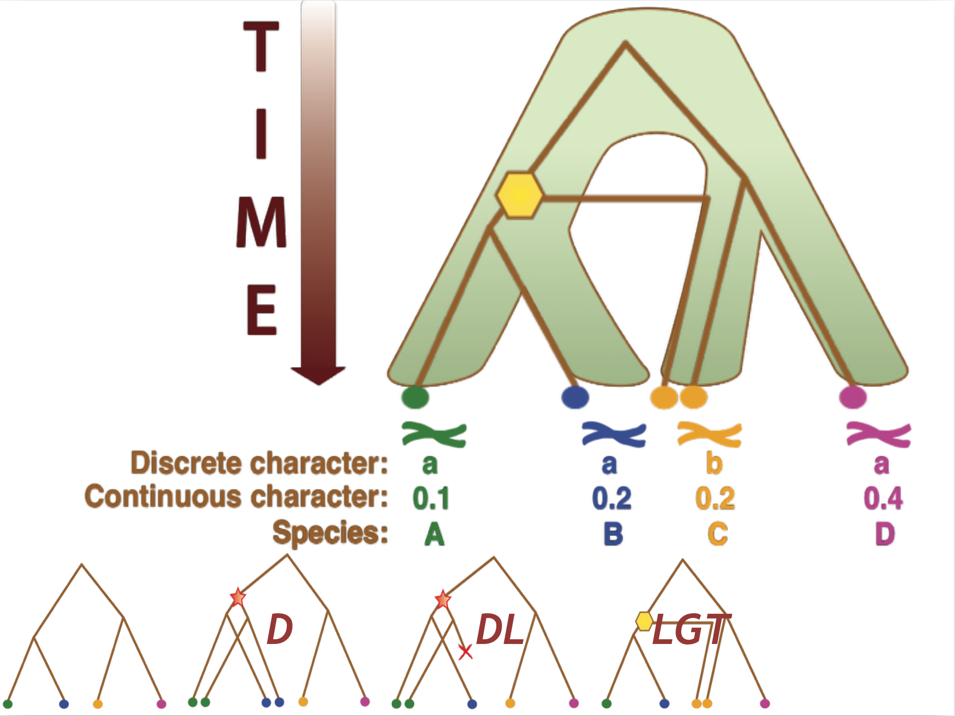
Biological processes creating incongruence
Notes:
Events of lateral gene transfer, also called horizontal gene transfer, can radically change a gene tree compared to a species tree. In the case presented here, a transfer from an ancestor of AB to an ancestor of C has been fixed in the C species, which now have two copies of the gene. Sometimes, genes can be replaced by transfers, but this is not systematic.

Slide 16
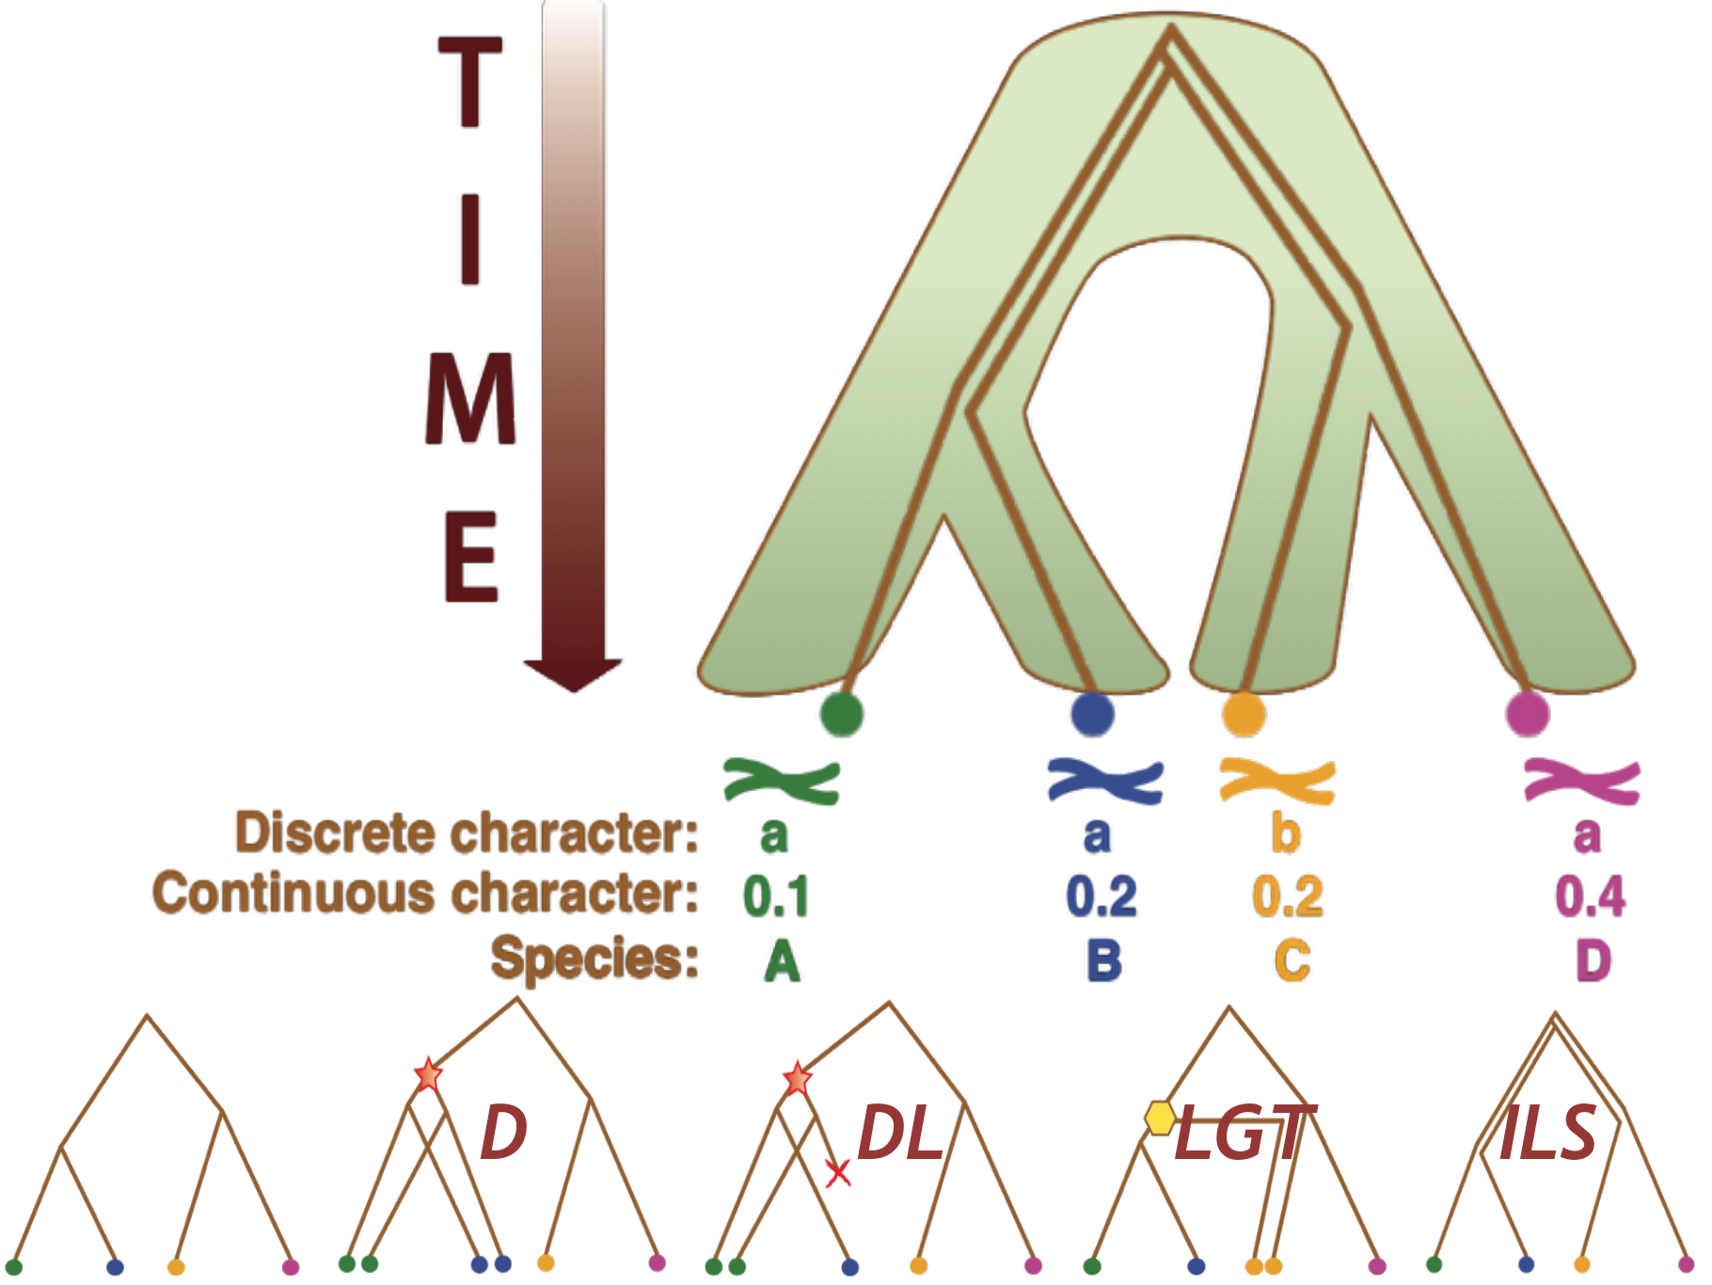
Biological processes creating incongruence
Notes:
Finally, gene trees and species trees can differ due to Incomplete Lineage sorting. Because a gene tree based on orthologous genes is actually an allele tree, what we get is the history of the alleles, which can differ from the species tree. I this case, there were 4 alleles already present in the common ancestor of ABCD, and these 4 alleles got sorted independently and randomly. As a consequence, the species tree and the gene trees differ (here the gene tree groups together B and C).

Slide 17
Plan
The need for gene tree species tree models
Using a model of gene transfers, duplications and losses (DTL) to reconstruct species and gene trees
Using a DTL model to compare genome evolution in Fungi vs Cyanobacteria
Using a DTL model to reconstruct ancestral genomes in Archaea
Using a DTL model to date species phylogenies

Slide 18
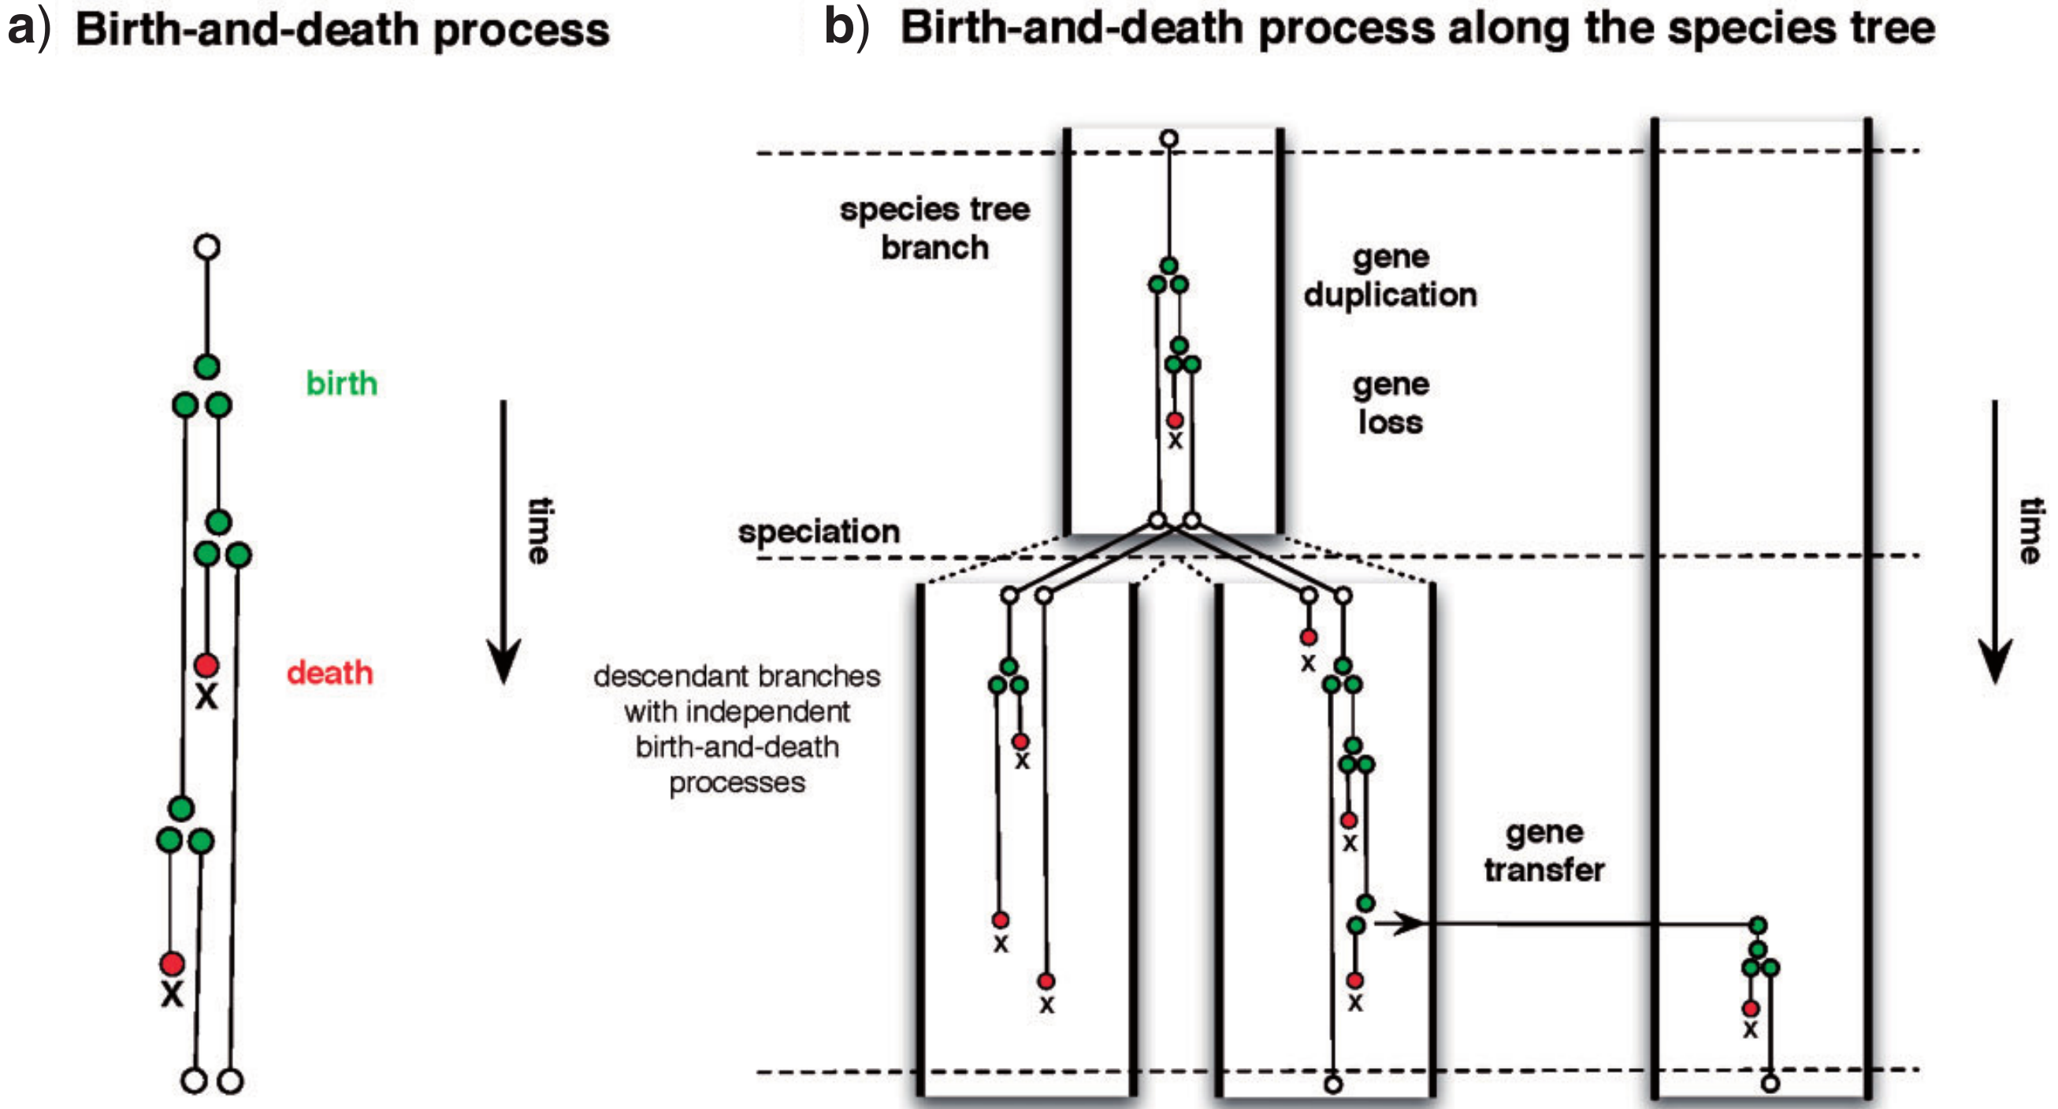
Modelling gene family evolution within a species tree
Szöllősi et al. Syst. Biol. 2015

Slide 19
Modelling gene family evolution within a species tree
Szöllősi et al. Syst. Biol. 2015

Slide 20
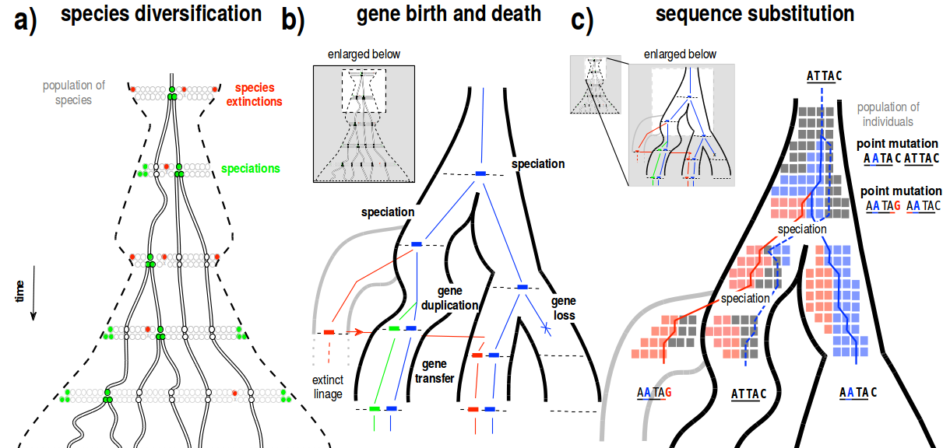
Hierarchical model of sequence evolution
Szöllősi et al. Syst. Biol. 2015

Slide 21
Hierarchical model of sequence evolution
**Caveat**
Lots of reconstruction methods do not use dated trees :
they allow placing DTL events on branches of the species tree
they do not date them in time
Szöllősi et al. Syst. Biol. 2015

Slide 22
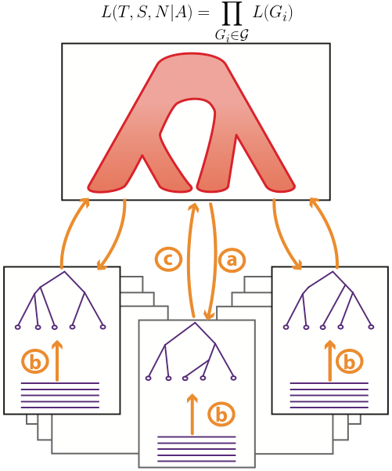
Inference with gene tree-species tree models
Inference made by maximizing a score (e.g. ML) or sampling according to a posterior probability distribution (e.g. Bayesian MCMC)
Often computationally intensive
Some have been parallelized
Some focus on inferring good gene trees, others on inferring a good species tree, others on both
Notes:
This sharing of information is used in GTST models, which are based on a probabilistic description of sequence evolution (b) and of gene family evolution (a/c).

Slide 23
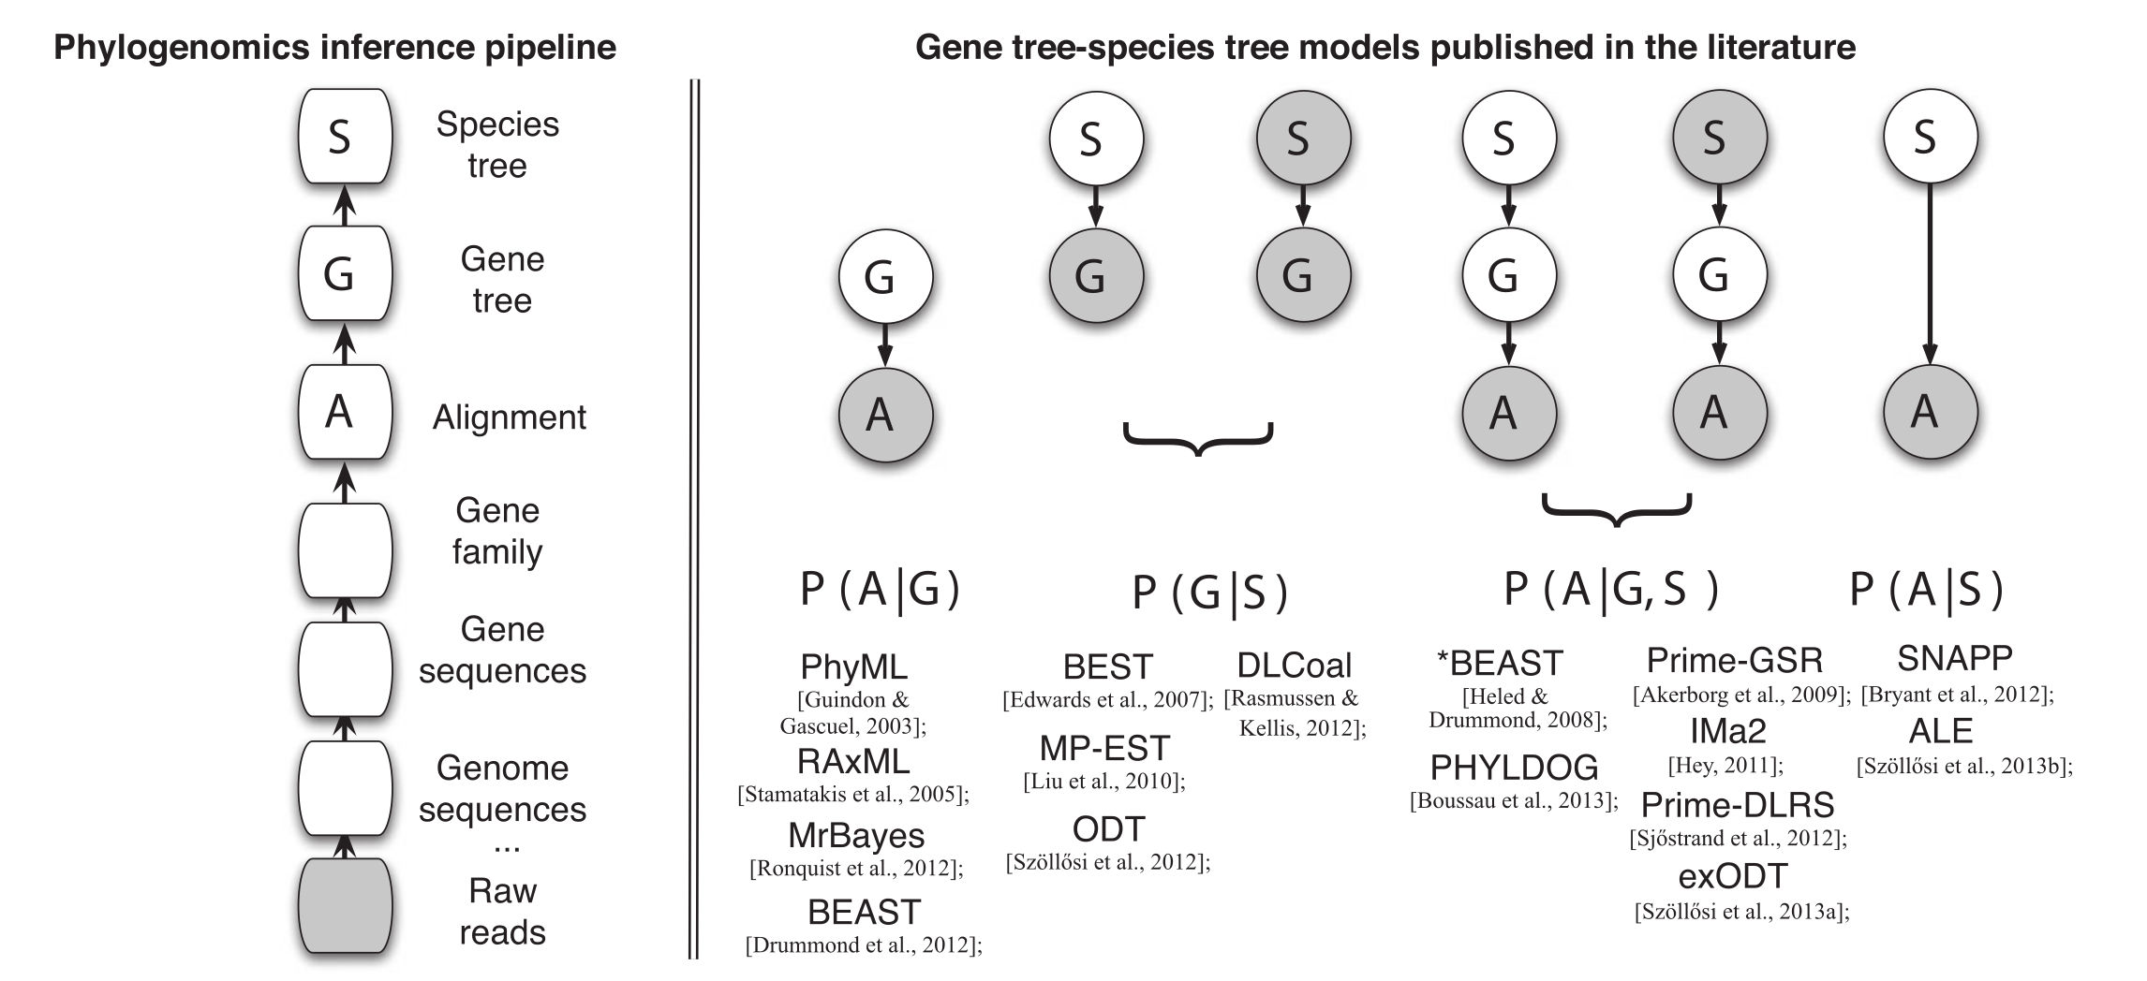
Different methods target different problems
GeneRax (Morel et al. 2020)
Treerecs (Comte et al. 2020)
Szöllősi et al. Syst. Biol. 2015

Slide 24
Without GTST models, there may be shortage of information
GT1
GT2
GT3
GT4
Notes:
The reason is that in a single alignment there may not be enough information for inferring a gene tree. For instance here Gene Tree 4 may be based on an alignment that is too short or too conserved or too divergent, so that its gene tree is unresolved, at least on some branches.

Slide 25
GTST models allow sharing of information thanks to a hierarchical model
Species
tree
GT1
GT2
GT3
GT4
Notes:
In a GTST model, there is a flow of information that can help improve gene trees. Here the flow of information coming from the species tree to GT4 can help improve the gene tree on branches where there is not enough information for a good inference.

Slide 26
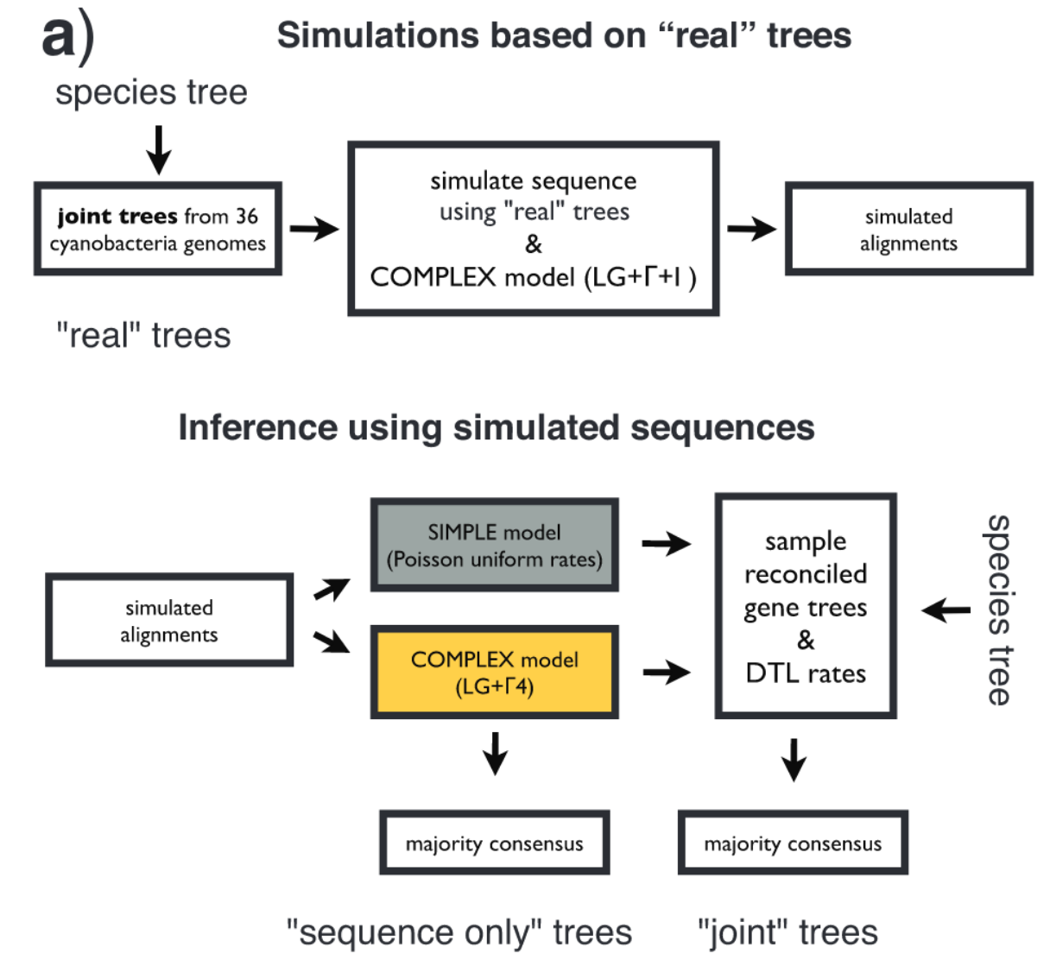
Gene trees improved with a GTST model
Protocol:
- use reconstructed gene trees
- simulate sequence evolution along those gene trees using a LG model + Discrete Gamma distribution to model rate heterogeneity across sites. Sequence sizes match true sequences.
Szöllősi et al. Syst. Biol. 2013
Notes:
Here we present another example of the same phenomenon, i.e. the removal of noise in gene tree estimates by using a GTST model. However this time it is a duplication/transfer/loss (DTL) model.
This experiment is based on simulations. Parameters of the simulation were drawn from an empirical data set (1099 putatively orthologous families from 36 Cyanobacteria), and sequence alignments were simulated using a complex model of sequence evolution (LG+Gamma+I).

Slide 27
Gene trees improved with a GTST model
Protocol:
- use reconstructed gene trees
- simulate sequence evolution along those gene trees using a LG model + Discrete Gamma distribution to model rate heterogeneity across sites. Sequence sizes match true sequences.
Szöllősi et al. Syst. Biol. 2013
Notes:
Based on those simulated alignments, 4 types of reconstructions were performed, changing 2 variables: the model of sequence evolution, and whether or not a GTST model was used. In grey, we present results obtained using a simple model of sequence evolution, where all transition rates are equal, and we ignore rate heterogeneity across sites. In yellow, we use the same model that was used in the simulations. Those two models are used either in the absence or in the presence of a GTST model.

Slide 28
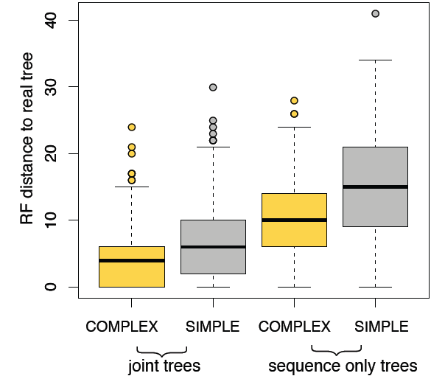
Gene trees improved with a GTST model
Szöllősi et al. Syst. Biol. 2013
Notes:
The results show that GTST models help a lot for recovering good gene trees (close to the true gene trees used in the simulations). On the Y axis is presented the unnormalized RF distance to the true trees, and on the X axis “joint trees” mean that a GTST model was used, and “sequence only trees” means that the trees were reconstructed by a more standard algorithm (in this case, PhyML). We can see that overall GTST models help a lot; in fact even if they are used with the simple (incorrect) model of sequence evolution, they achieve a better accuracy than PhyML with the correct model of sequence evolution.

Slide 29
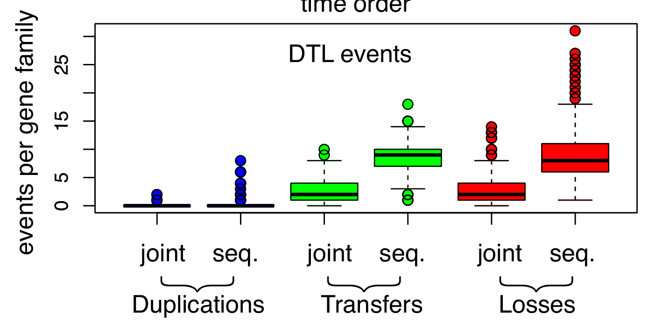
Gene trees improved with a GTST model
Szöllősi et al. Syst. Biol. 2013
Notes:
The results show that GTST models help a lot for recovering good gene trees (close to the true gene trees used in the simulations). On the Y axis is presented the unnormalized RF distance to the true trees, and on the X axis “joint trees” mean that a GTST model was used, and “sequence only trees” means that the trees were reconstructed by a more standard algorithm (in this case, PhyML). We can see that overall GTST models help a lot; in fact even if they are used with the simple (incorrect) model of sequence evolution, they achieve a better accuracy than PhyML with the correct model of sequence evolution.

Slide 30
Plan
The need for gene tree species tree models
Using a model of gene transfers, duplications and losses (DTL) to reconstruct species and gene trees
Using a DTL model to compare genome evolution in Fungi vs Cyanobacteria
Using a DTL model to reconstruct ancestral genomes in Archaea
Using a DTL model to date species phylogenies

Slide 31
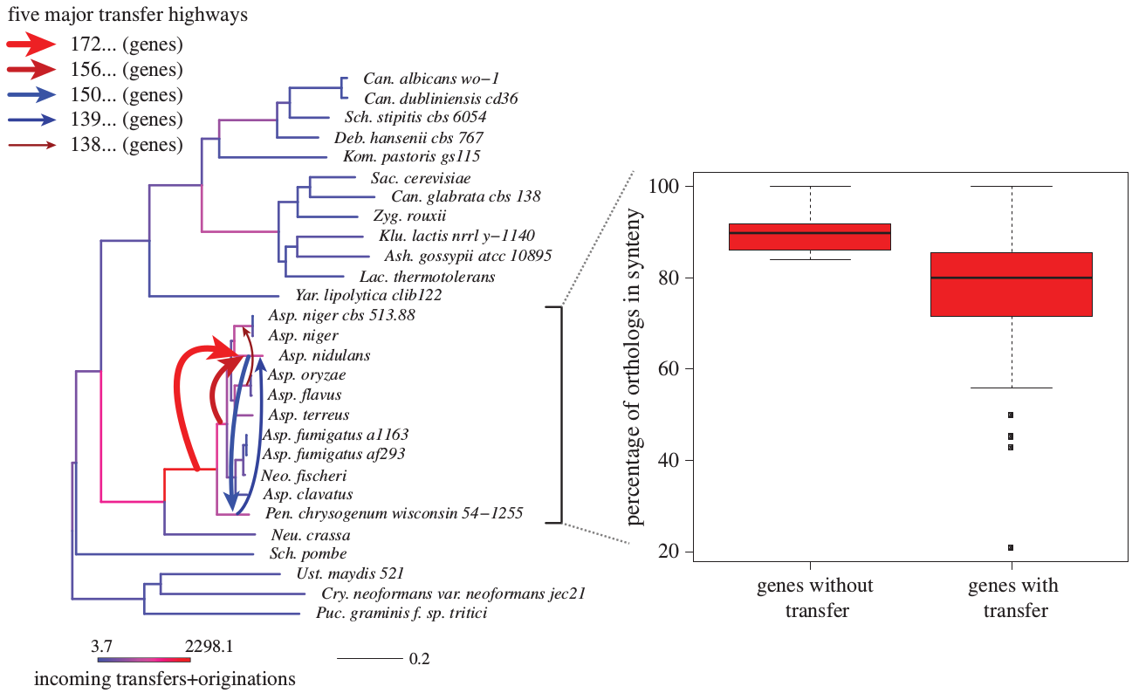
Highways of gene transfers in Fungi
Szöllősi et al., Phil Trans 2015

Slide 32
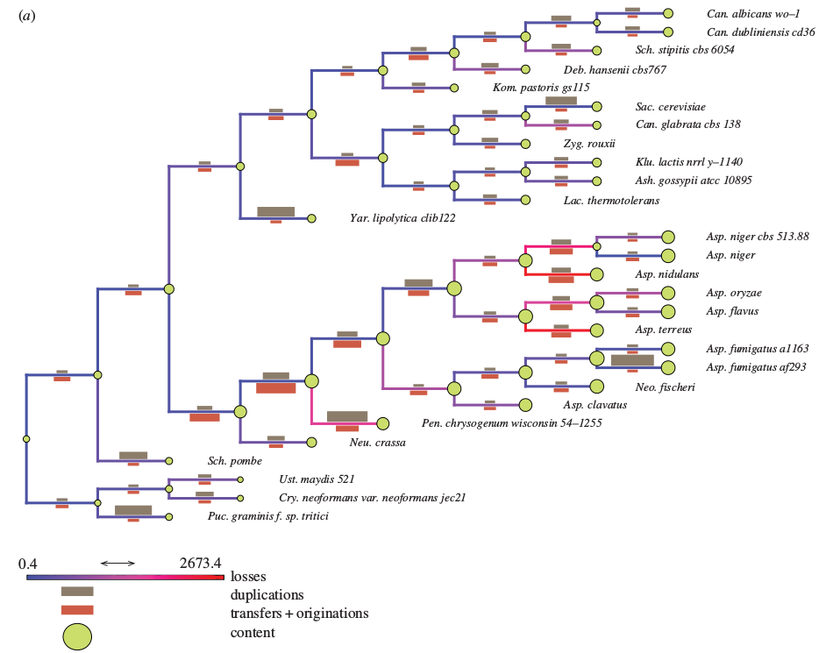
Genome evolution in Fungi
Szöllősi et al., Phil Trans 2015

Slide 33
Plan
The need for gene tree species tree models
Using a model of gene transfers, duplications and losses (DTL) to reconstruct species and gene trees
Using a DTL model to compare genome evolution in Fungi vs Cyanobacteria
Using a DTL model to reconstruct ancestral genomes in Archaea
Using a DTL model to date species phylogenies

Slide 34
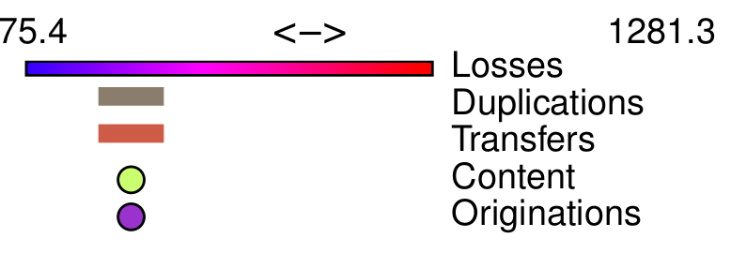
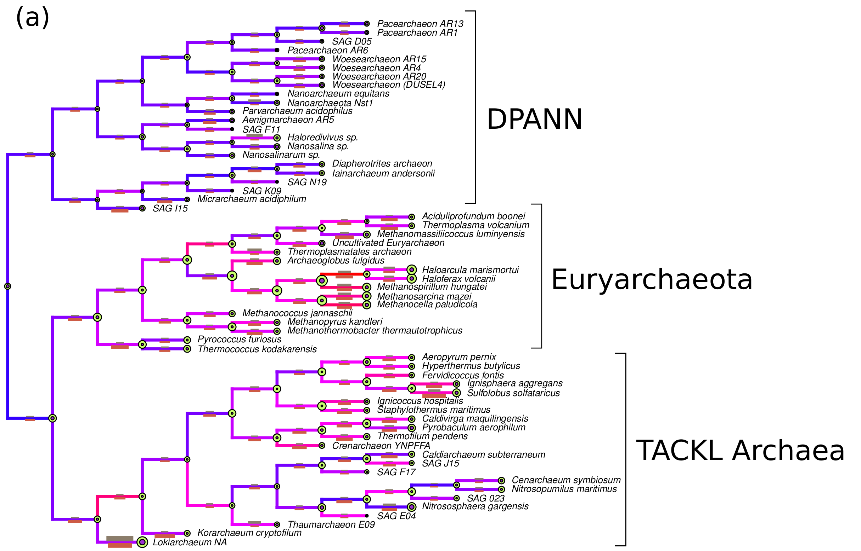
Inferring ancient lifestyles from ancestral gene contents
Williams et al. PNAS 2017

Slide 35
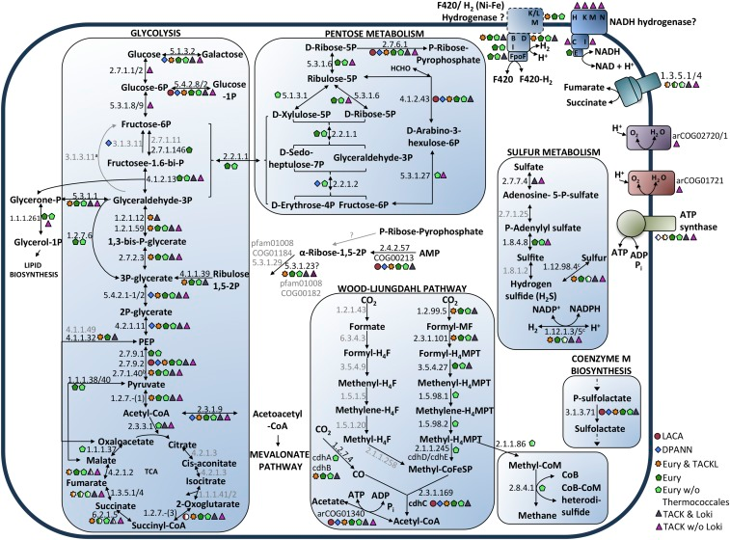
Inferring ancient lifestyles from ancestral gene contents
Williams et al. PNAS 2017

Slide 36
Inferring ancient lifestyles from ancestral gene contents
The ancestor of Archaea:
- may have been an anaerobe
- may have been able to fix CO2 using the Wood-Ljungdahl pathway
- may have been able to produce acetate and ATP thanks to an acetyl-CoA synthetase
- also may have had most of the RNA/DNA archaeal machinery, exosome and proteasome, secretion system, lipid synthesis system
- oxidative phosphorylation seems to have been acquired several times independently later during Archaeal evolution
Williams et al. PNAS 2017

Slide 37
Plan
The need for gene tree species tree models
Using a model of gene transfers, duplications and losses (DTL) to reconstruct species and gene trees
Using a DTL model to compare genome evolution in Fungi vs Cyanobacteria
Using a DTL model to reconstruct ancestral genomes in Archaea
Using a DTL model to date species phylogenies

Slide 38
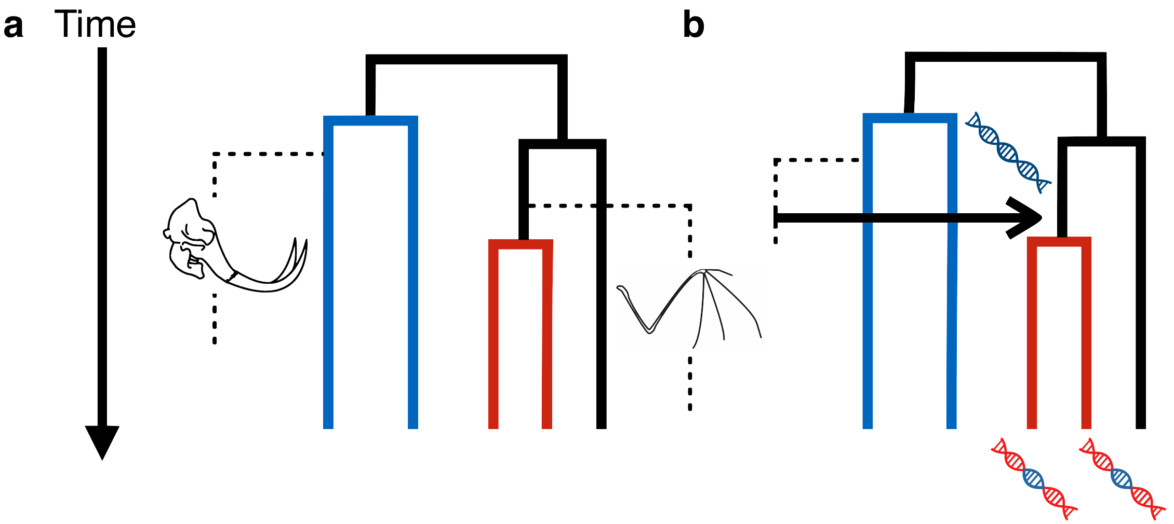
How transfers carry information about relative time
Fossils carry absolute timing information
Davín et al., Nature EE 2018

Slide 39
How transfers carry information about relative time
Fossils carry absolute timing information
Transfers carry relative timing information
Davín et al., Nature EE 2018

Slide 40
Dating with gene transfers
There is a very large number of transfers that may provide a huge amount of unexplored information for dating
This information is most abundant in clades that do not fossilize well
Beyond gene transfers, other transfers may be useful, for instance transfers of microbiota or parasites between host species

Slide 41
Combining clocks and transfers
Chronograms that disagree with a relative constraint get a 0 probability
Compatible with existing tree priors
Compatible with all relaxed clocks and other models
New move to ease MCMC mixing
Method implemented in RevBayes (https://github.com/revbayes)
Protocol :
estimate gene trees
detect gene transfers using ALE (https://github.com/ssolo/ALE)
use highly supported gene transfers as constraints
compare dated Cyanobacteria phylogeny with constraints to phylogeny dated with fossil calibration

Slide 42
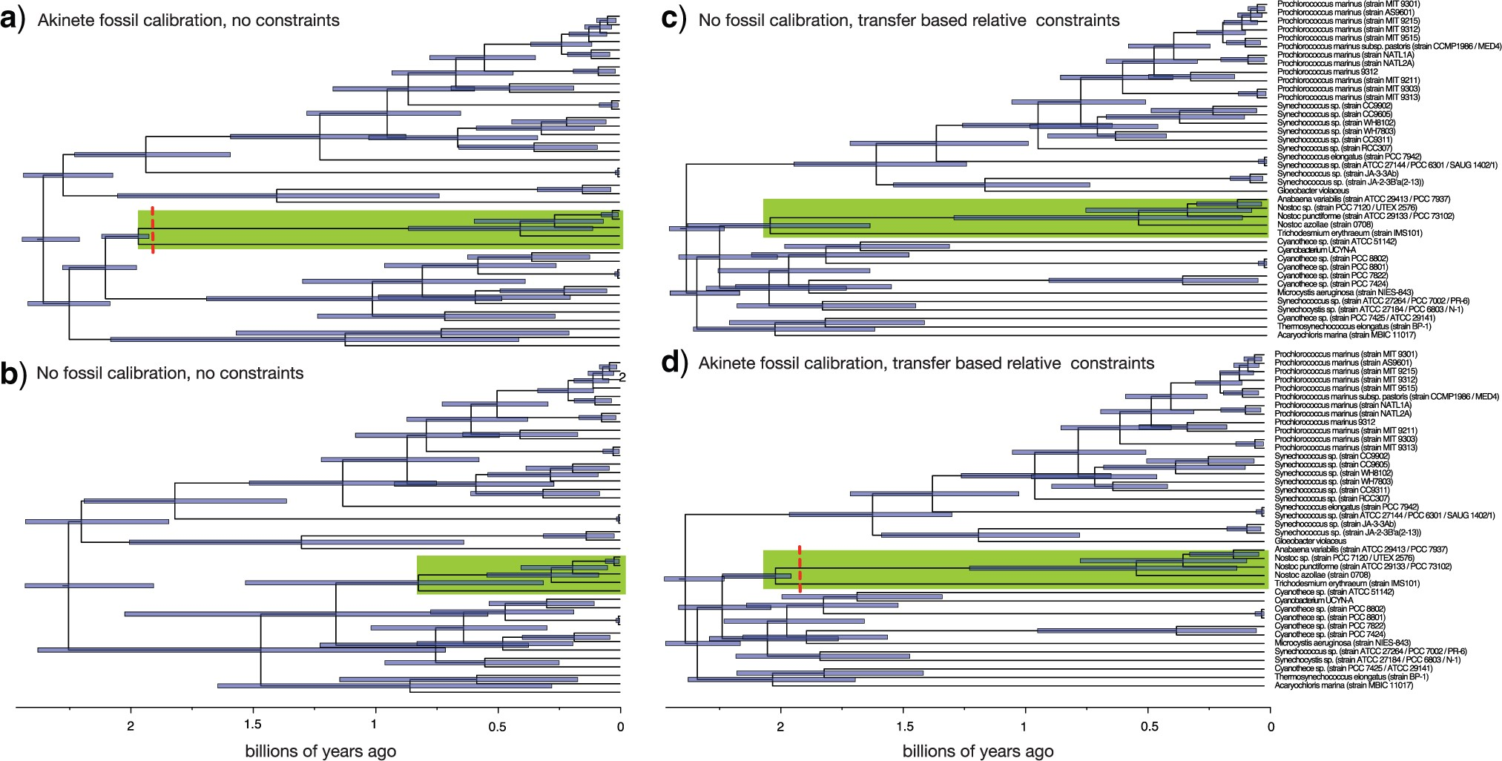
Constraints improve dating
Szöllősi et al., Syst Biol 2021

Slide 43
Conclusion
Species tree-gene tree models allow propagating uncertainty from gene tree reconstruction into species tree reconstruction
They enable more accurate gene tree reconstruction
We can reconstruct ancestral genomes and infer ancient metabolisms and lifestyles
ALE detects transfers that carry bona fide dating information
This information in found across the tree of life
We can combine transfer-based constraints with fossil calibrations and relaxed molecular clock

Slide 45
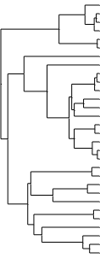
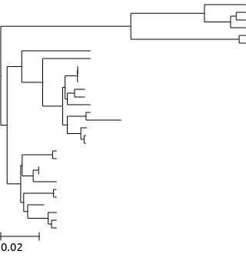
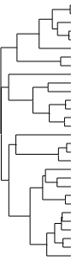
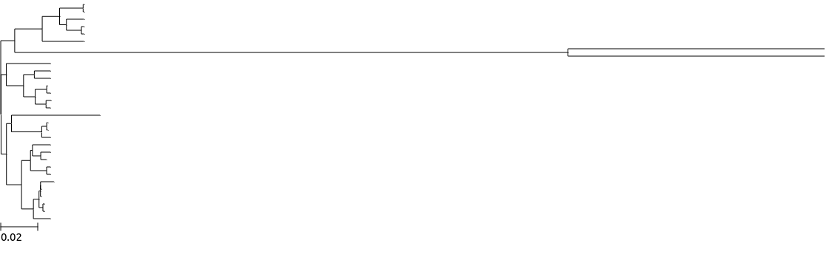
Simulating deviations from the clock
Place on each branch small rate changes (with a high probability) and large rate changes (with a low probability).
The probabilities of placing changes on a given branch do not depend on their length

Slide 46
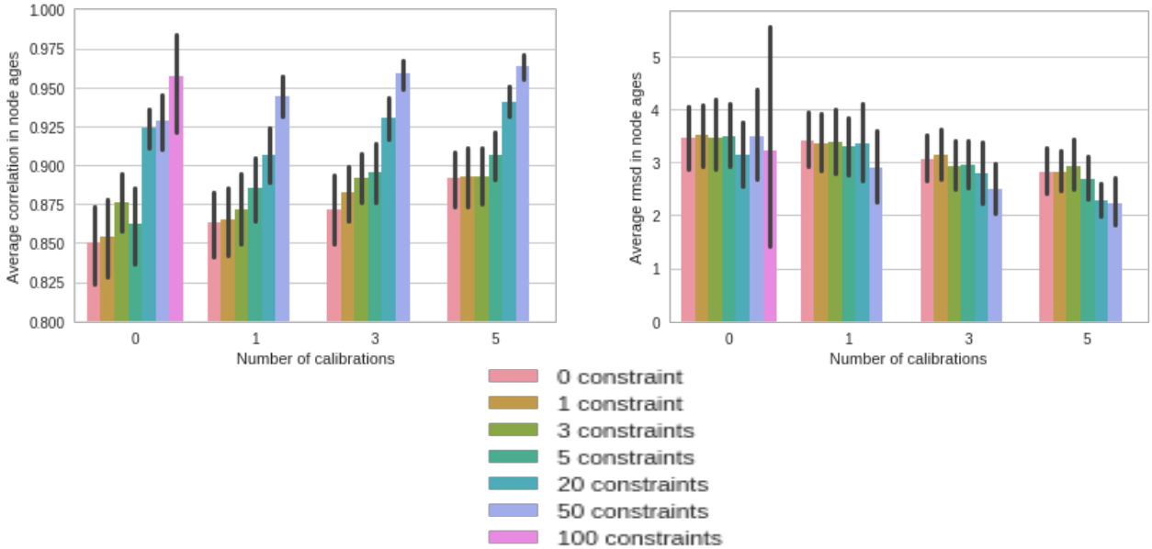
Relative constraints vs absolute calibrations

Slide 47
Relative constraints vs absolute calibrations

Slide 48
Dating Cyanobacteria with a calibrated relaxed clock and constraints
2 calibrations:
Origin of Cyanobacteria >2.45 Bya, <3.85 Bya
Origin of akinete-forming Cyanobacteria >1.957 Bya
Selecting constraints supported by more than 20 transfers: 51 constraints
Small subset of a concatenated alignment: 500 amino acid sites

Slide 49
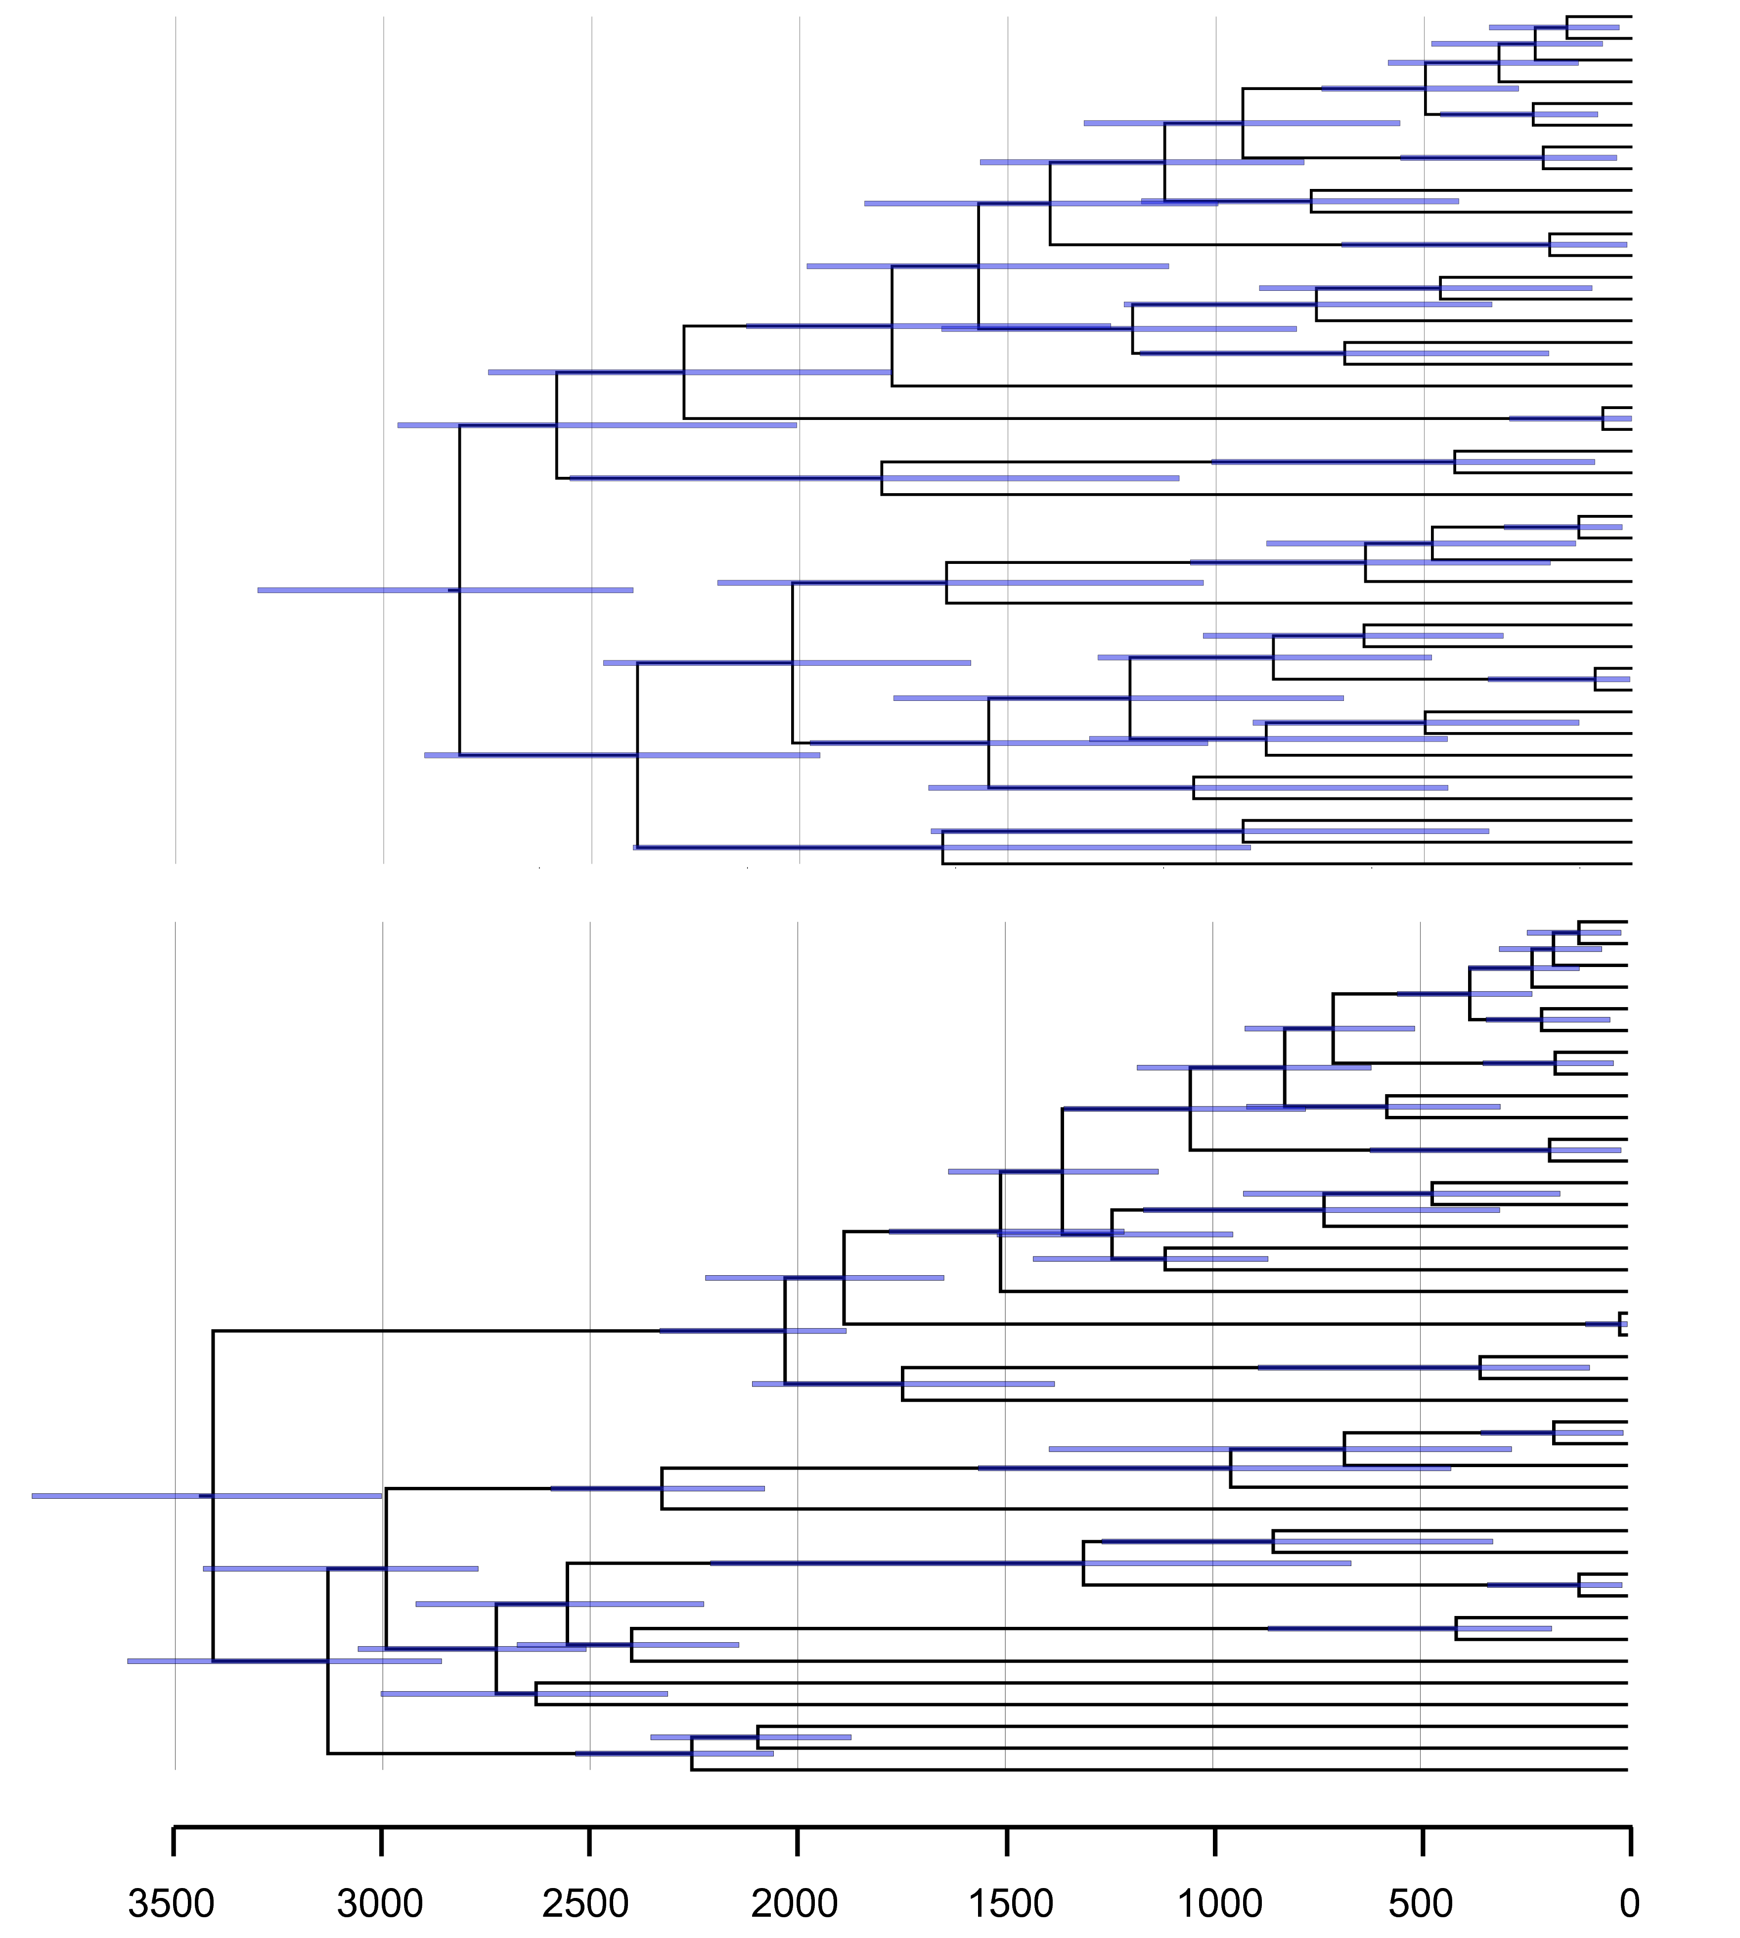
The effect of constraints on Cyanobacteria
Calibrated
Calibrated and constrained

Slide 50
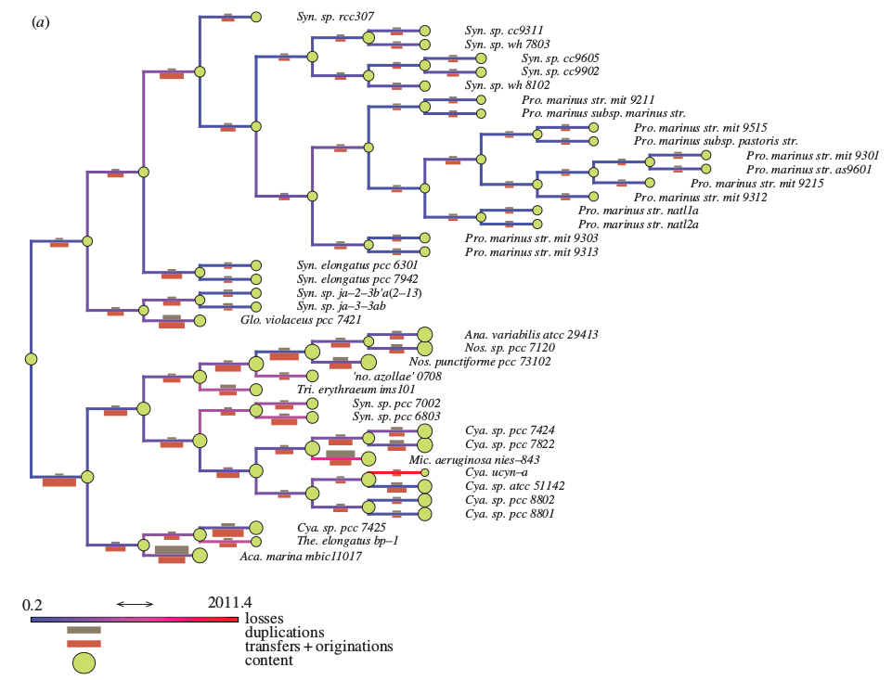
Genome evolution in Cyanobacteria
Szöllősi et al., Phil Trans 2015

Slide 51
The effect of constraints on Cyanobacteria
Calibrated
Calibrated and constrained

Slide 52
How we detect transfers
Several methods available
We use ALE:
Considers gene loss, duplication, transfer
Estimates rates (probabilistic model, ML or Bayesian statistical inference)
Handles gene tree uncertainty
Handles reconciliation uncertainty
Can handle genomes with missing data
https://github.com/ssolo/ALE
Szöllősi et al., 2012, 2013, 2013, 2015, 2015.

Slide 53
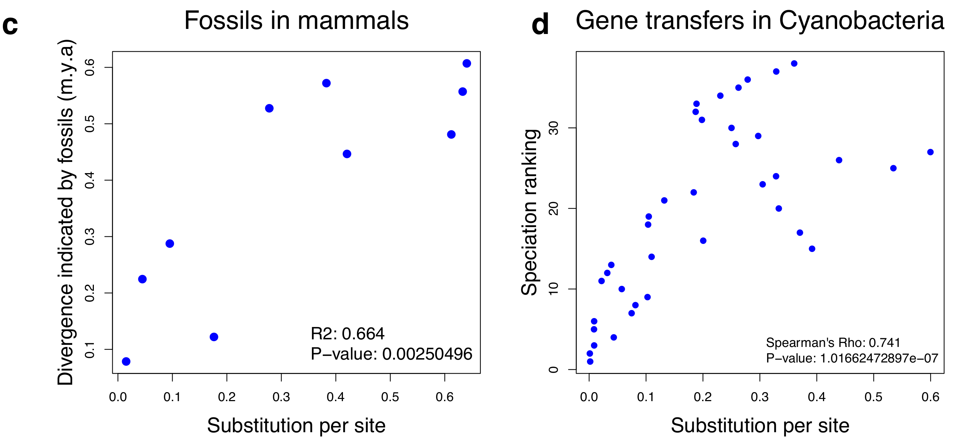
Transfers detected by ALE carry bona fide information
Davín et al., Nature EE 2018

Slide 54
Transfers detected by ALE carry bona fide information
Davín et al., Nature EE 2018

Slide 55
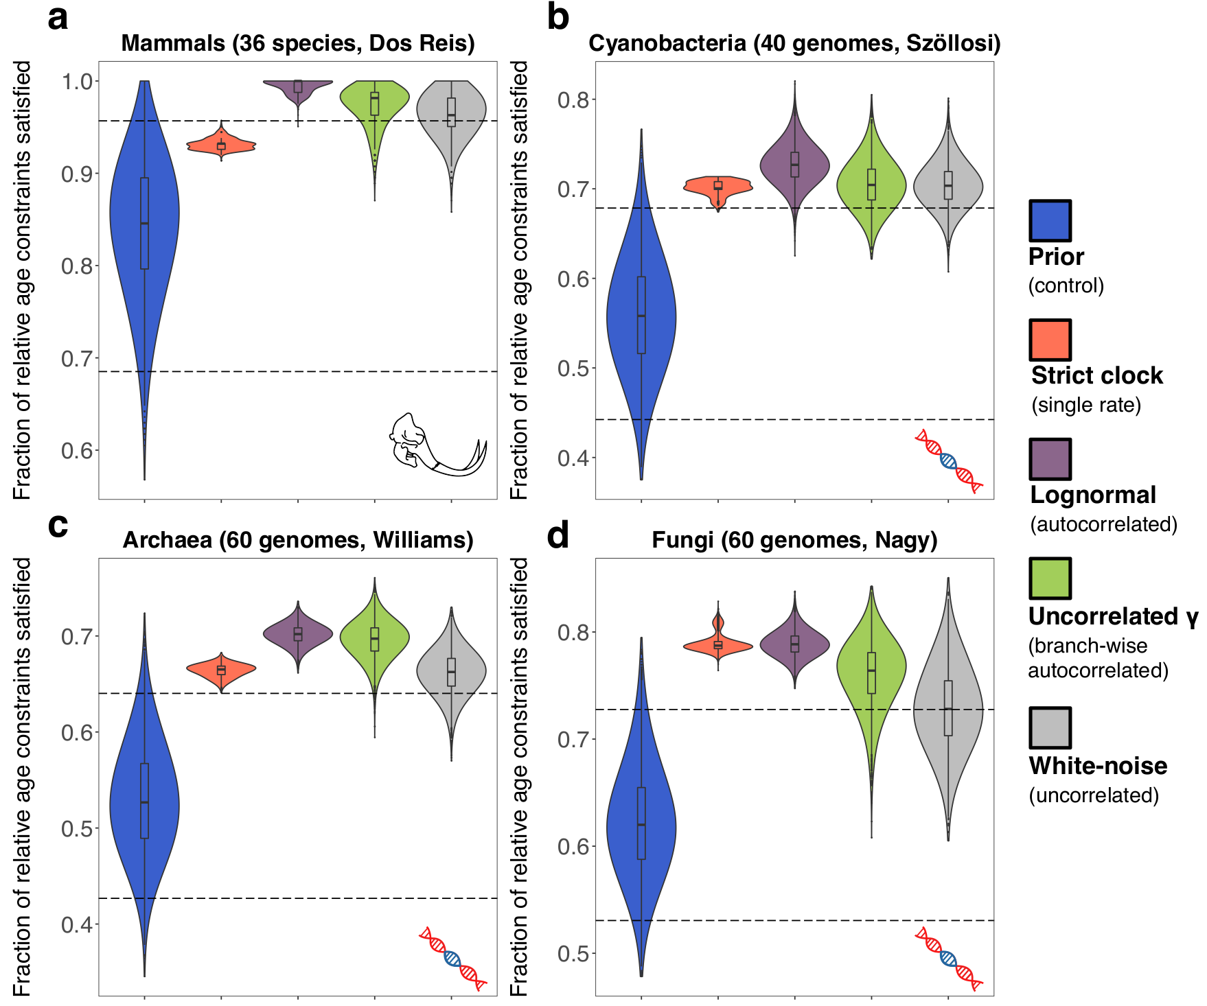
Gene transfers, like fossils, can date the tree of life
Davín et al., Nature EE 2018

Slide 56
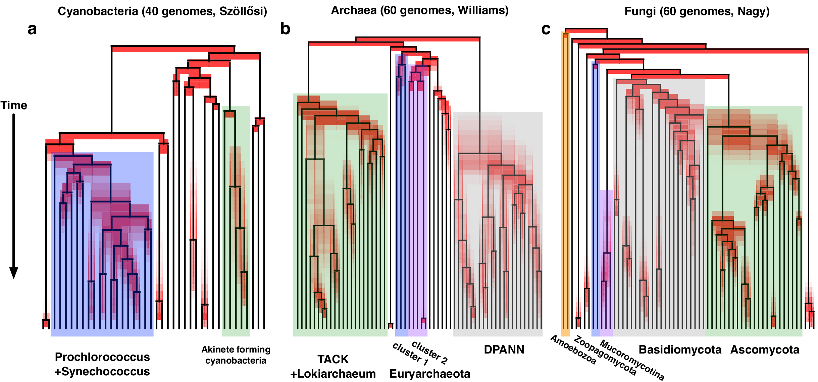
Dating with gene transfers
Davín et al., Nature EE 2018

Slide 57
Dating with gene transfers
In Archaea, transfers suggest methanogeny is an ancient metabolism. Consistent with geological results finding traces of methanogen metabolism ~3.5 billion years ago.
Davín et al., Nature EE 2018

Slide 58
Gene tree-species tree (GTST) inference
True gene trees and species trees differ due to many biological processes:
Gene duplication
Gene loss
Gene transfer/hybridization/reticulation
Incomplete lineage sorting
Reconstructed gene trees are often highly uncertain due to noise/errors: taking a single tree (e.g. ML, or MAP) is often misleading

Slide 59
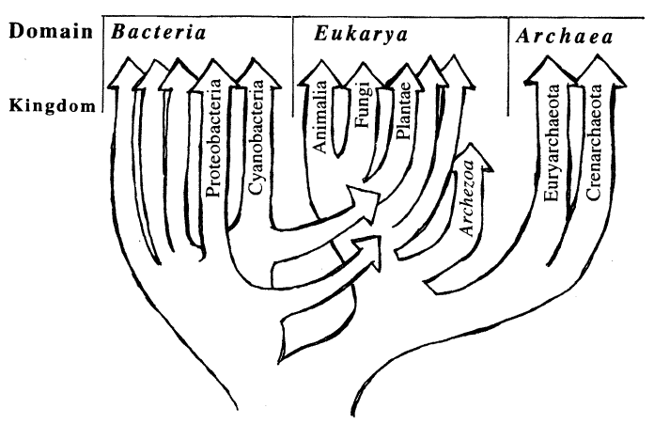
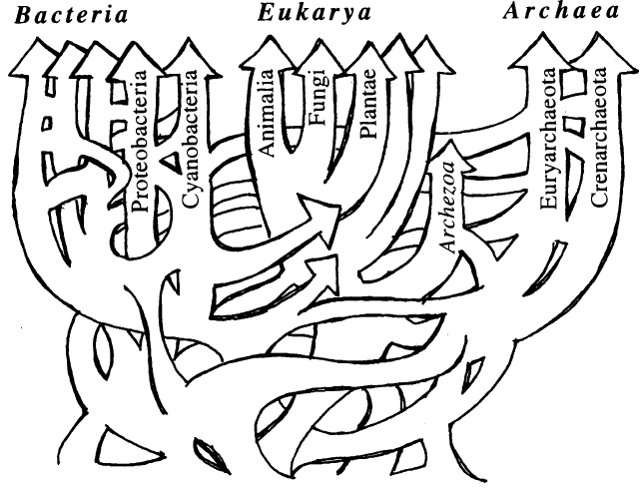
We can extract some signal from the noise
Amid the signal, is there trace of a tree of life?
Doolittle WF,
Science 1999

Slide 60
A model of gene duplication, loss, and transfer
Maximum Likelihood reconstruction of a time-ordered rooted species tree
Fixed gene trees
Parallel implementation
Tests on simulations
Tests on clades of prokaryotes based on thousands of gene families
e.g.: 36 complete genomes of Cyanobacteria, 8,332 families of homologous genes (77,678 genes in total)
Szöllősi et al., PNAS 2012

Slide 61
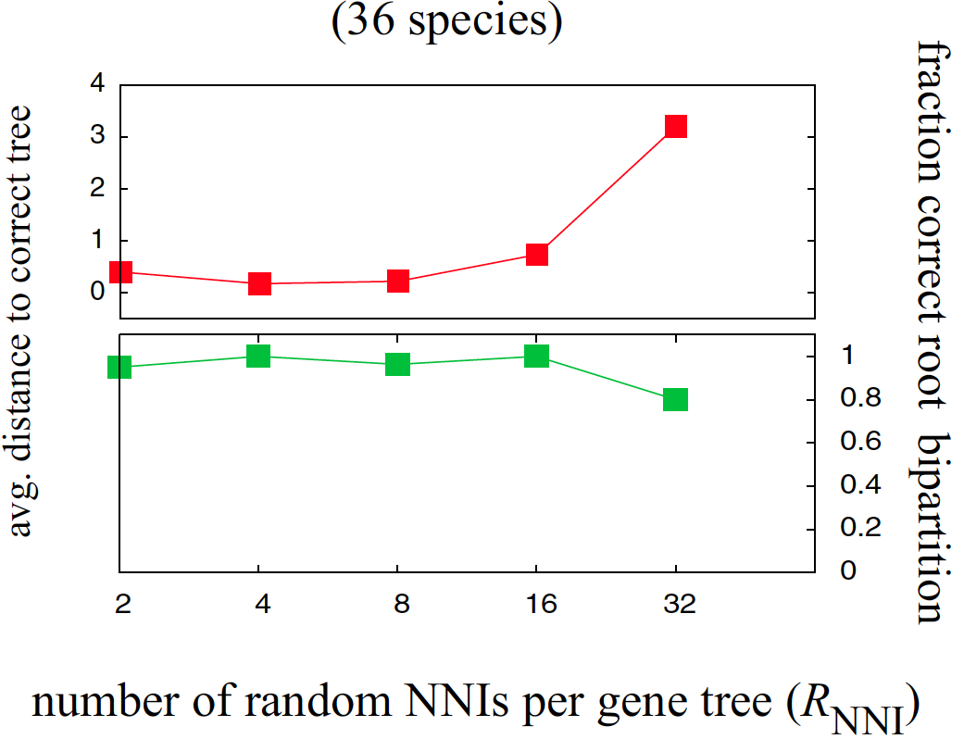
DTL GTST model provides accurate reconstruction of the species tree, robust to gene tree noise
Mean distance to correct tree
Fraction correct root bipartition
Szöllősi et al., PNAS 2012

Slide 62
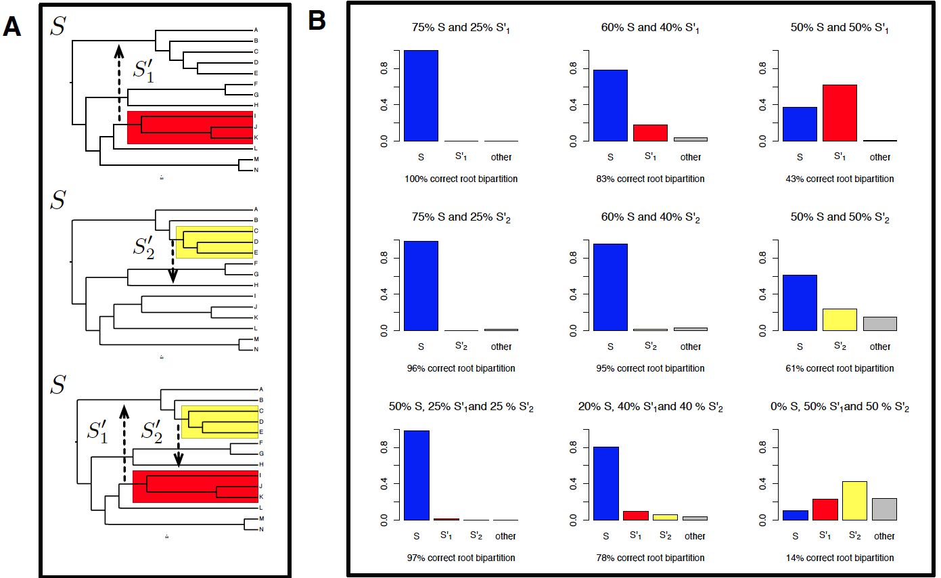
DTL GTST: robustness to highways of gene transfers
Szöllősi et al., PNAS 2012

Slide 63
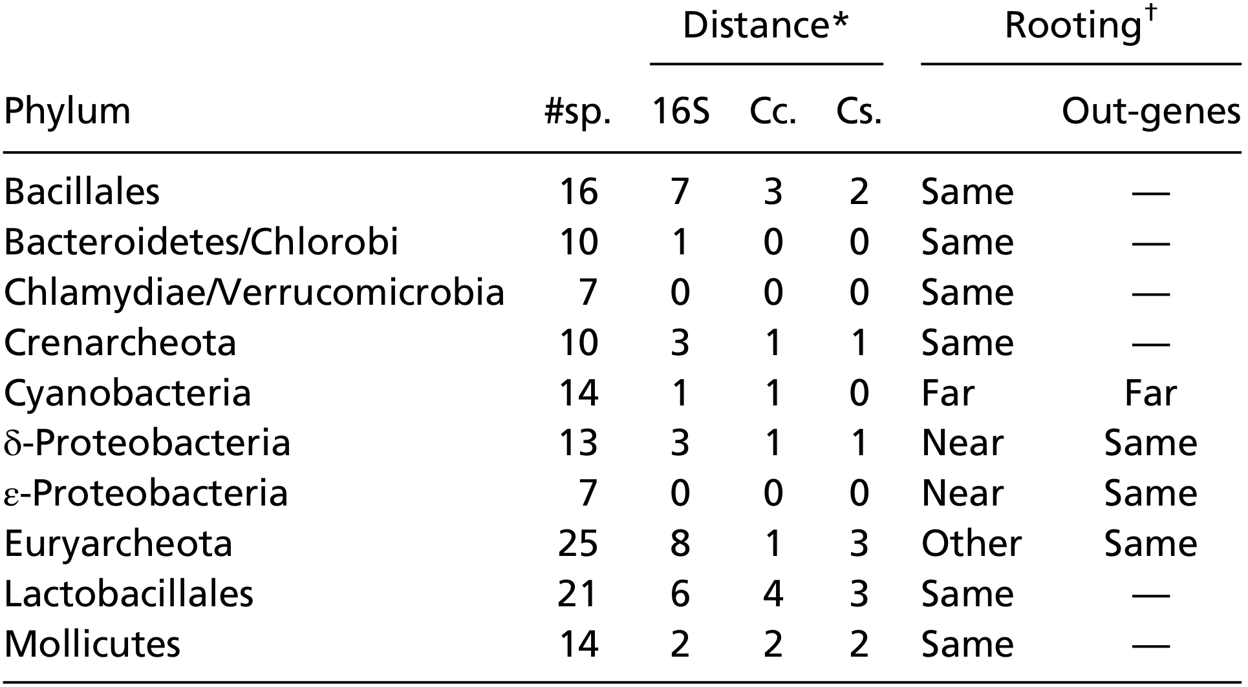
Whole genome reconstruction of species trees
Szöllősi et al., PNAS 2012

Slide 64
Whole genome reconstruction of species trees
Doolittle WF, Science 1999
Szöllősi et al., PNAS 2012

Slide 65
Gene transfers and the quixotic pursuit of the TOL
Doolittle and Bapteste 2007
Doolittle WF,
Science 1999
“The monistic concept of a single universal tree appears […] increasingly obsolete. […][It is] no longer the most scientifically productive position to hold[…][It] accounts for only a minority of observations from genomes.”
Bapteste, O’Malley, Beiko, Ereshefsky, Gogarten, Franklin-Hall, Lapointe, Dupré, Dagan, Boucher, Martin, Biology Direct 2009.

Slide 66
The need for a gene tree-species tree model
There is a lot of incongruence between gene trees, and therefore between gene trees and the species tree, if there is one
To know how much of it is biological and how much of it is methodological/noise, we need to model biological processes, notably gene transfers

Slide 67
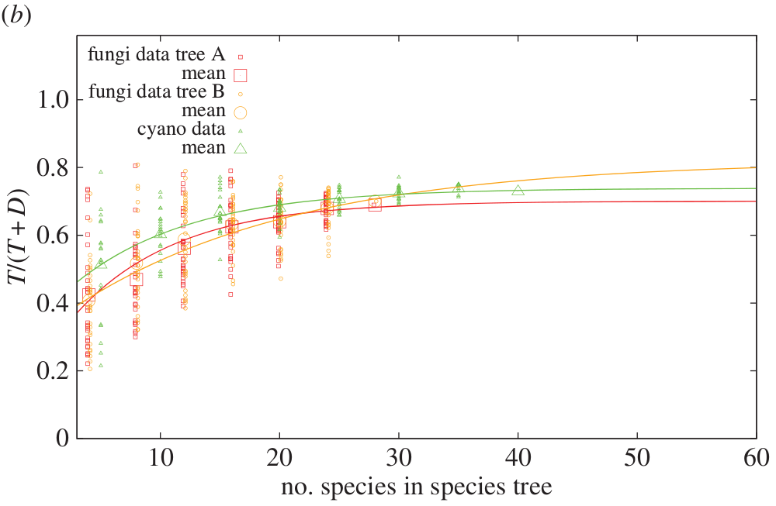
Similar rates of transfers in Cyanobacteria and Fungi, when normalized
Szöllősi et al., Phil Trans 2015

Slide 68
Reconstructing genome evolution in Fungi and Cyanobacteria
There had been some claims for occasional gene transfers in Fungi, but no systematic genome-wide study
We wanted to see how rates of gene transfer in Fungi compare to those in Cyanobacteria
Fungi: 28 species, 11 387 gene families
Cyanobacteria: 40 species, 7 415 gene families

Slide 69
Why should we care about gene transfers?
Frequent in Bdelloid rotifers? (Gladyshev et al. 2008)
Transfers between fungi and aphid (Moran and Jarvik 2010)
Transfers among plant mitochondria (Bergthorsson et al. 2003)
Transfers of transposable elements between Drosophila
Transfer of an antifreeze protein between fishes (Graham et al. 2008)
Transfer from Trypanosome to human (Hecht et al. 2010)
Frequent in unicellular Eukaryotes (Keeling and Palmer, 2008)
Frequent in Bacteria and Archaea

